Slide 1
Docker: Containerisation

Slide 2
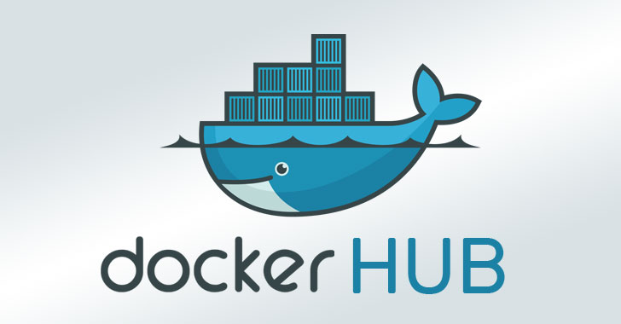

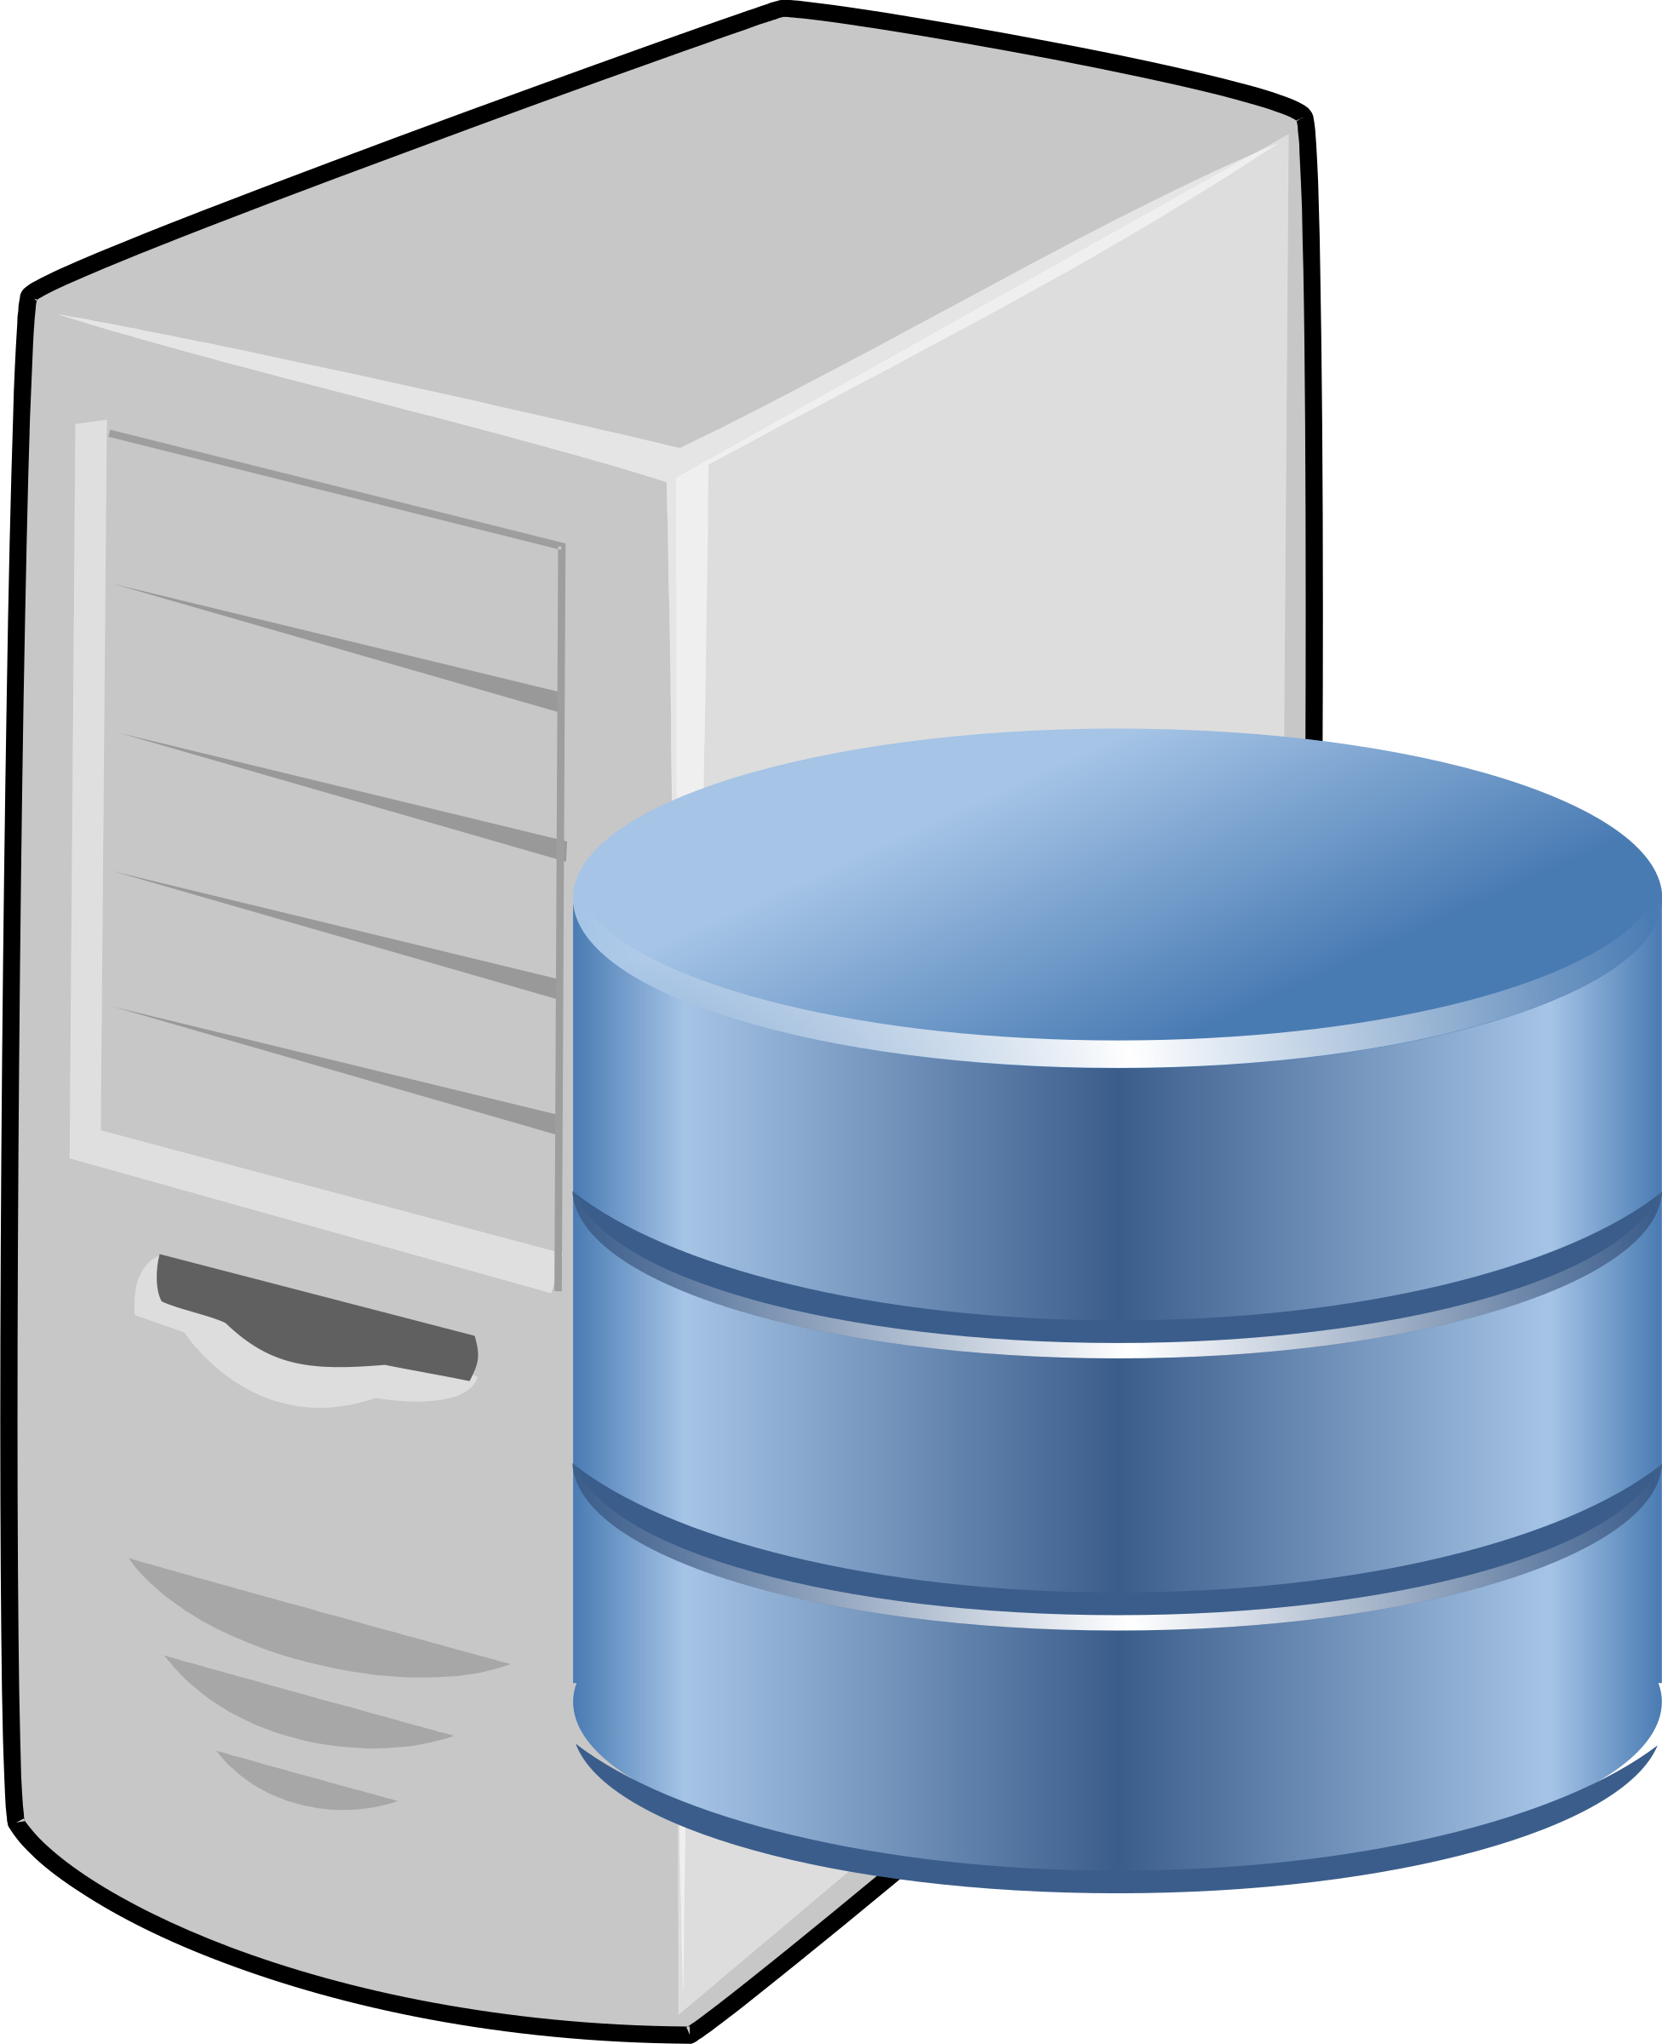
Software Deployment
push
Docker image
Traditional
Container-based
pull
.java
.sql
Developer machine
Developer machine
Client: Write code (.java, .sql)
Client: Compile, test on the client
Server: Install Java, MySQL, Spring Boot, …
Client: Copy .class/.jar/.war files and .sql files on the server
Server: Test
Client: Create microservices (.java, .sql)
Client: Compile, test on the client
Client: Create .jar/.war file and push Docker image
Server: Pull Docker image
Server: Run Docker image as a Container

Slide 3
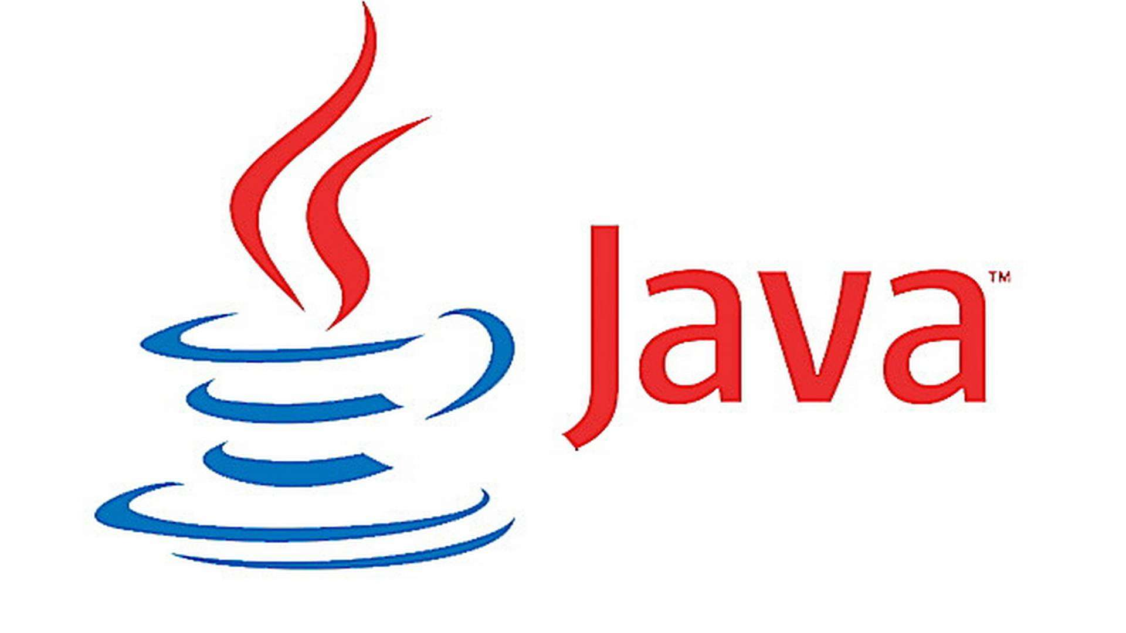
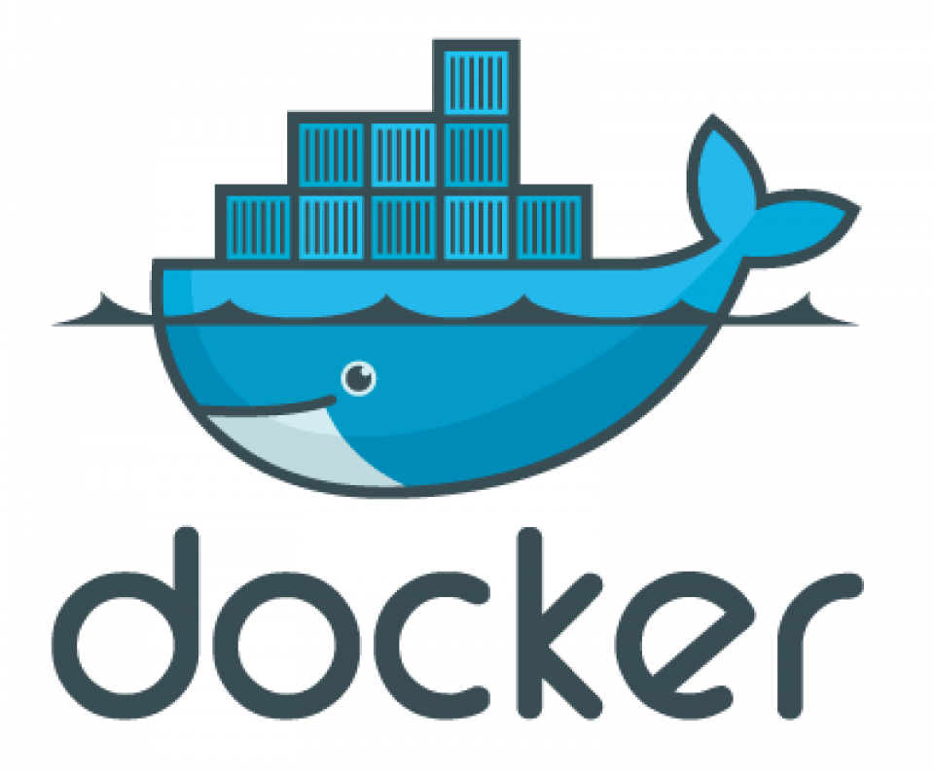

What is Docker?
HelloWorld.class
Docker: Container technology
Container = Complete and isolated software
Runs an application in a sandbox
Portable
Contains all dependencies
We can run several containers on a machine at the same time
Self-contained: Do not alter the host system they run on
Docker is light-weight, unlike VM
If something works in Development, it will work in Production, too

Slide 4
More on Docker
Provides an easy way to create images and run as containers
Ready images can be pulled from DockerHub and used
Uses a layered file system so that we can add to these base images
One container = One application, One VM = Multiple applications
Containers are isolated from each other
To create our own image, we need to create a Dockerfile
Dockerfile: Configuration details for creating an image
Ideal for Microservices/APIs

Slide 5
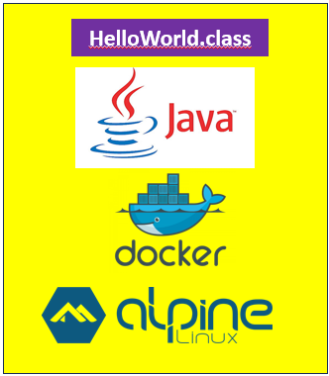
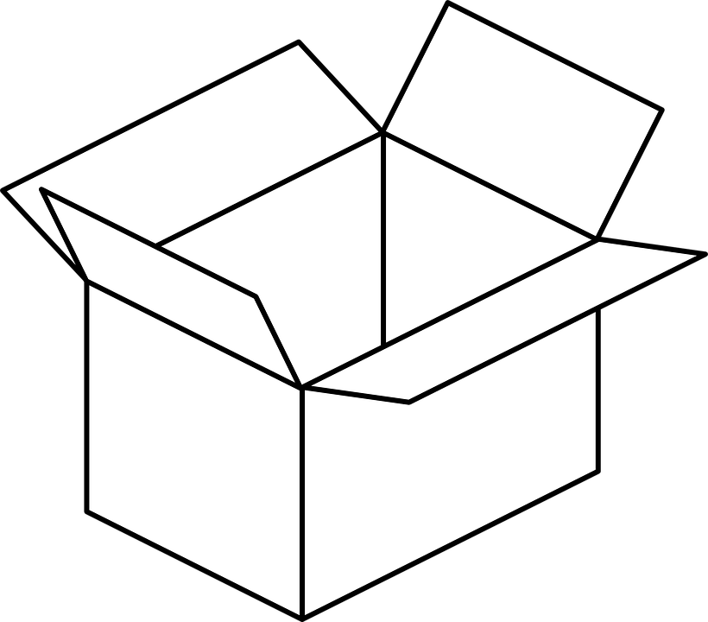
Image and Container
Build: Create an image
Run: Run the image as a container
Image
docker build command
Image
Container
docker run command

Slide 6
Container versus Virtual Machine
Containers
Virtual Machines
Container A
Container B
Container C
VM A
VM B
VM C
App A
App B
App C
App A
App B
App C
Libs
Libs
Libs
Libs
Libs
Libs
Guest OS
Guest OS
Guest OS
Docker
Hypervisor
Host Operating System
Host Operating System
Hardware
Hardware

Slide 7
Docker Installation on Windows
Enable virtualization
Search for ‘Turn Windows Features on or off’
Then check the relevant checkboxes, if required and restart
Download and install Docker Desktop: https://www.docker.com/products/docker-desktop/

Slide 8
Docker Installation on Ubuntu 22.04/Above
How to find what is our current Linux distribution? cat /etc/os-release
How to find what is our current Linux release? uname -srm
Link: https://docs.docker.com/engine/install/ubuntu/#install-using-the-repository
Checking running status: sudo systemctl status docker
Enabling Docker: sudo systemctl enable docker
Starting Docker: sudo systemctl start docker

Slide 9
Solve Docker Permission Errors (Linux)
Check current groups for our user: groups
Add our user to the docker group: sudo usermod -aG docker $USER
Refresh the group membership: newgrp docker
Check Docker socket permissions: ls -l /var/run/docker.sock
Output should be something like this:
srw-rw---- 1 root docker 0 May 17 10:00 /var/run/docker.sock
If not, try these commands:
sudo chown root:docker /var/run/docker.sock
sudo chmod 660 /var/run/docker.sock
Restart Docker service: sudo systemctl restart docker
Verify: docker ps

Slide 10
Run a Container
docker run -dit ubuntu
Run the ubuntu OS inside a Docker container on our local machine
Note: The image is not available locally
It is pulling it from DockerHub
-dit: Run in detatched mode and have an interactive terminal open
In the end, it shows the container id

Slide 11
View Running Container List
docker container list OR
docker ps
See all the running containers
Note that there is a randomly generated container name and id

Slide 12
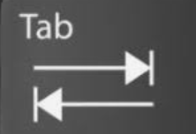
Stop a Container
docker stop b3
Here, b31 is assumed to be the ubuntu container id’s first three characters
We can also stop a container by its name
Again run the container and stop by its name
docker run -dit ubuntu
docker stop be
Assuming that the container name was beautiful joe: Verify it stopped
docker container list

Slide 13
View Image List
docker images
Shows list of Docker images on our local machine
Note how much size it occupies (generally in MB)

Slide 14
Inspect a Container
docker inspect 89
89 is assumed to be the start of a container’s id

Slide 15
Pull an Image
docker pull nginx
Pull the image from DockerHub onto our local machine
Check using docker images
Note: Pulling an image does not run a container using it
See how nginx image was created: docker history nginx

Slide 16
Delete an Image
docker rmi nginx-stable
It will untag the image (mark it as unused or dangling)
docker images
To remove the image completely (like garbage collection)
docker image prune
How much disk space is Docker using?
docker system df

Slide 17
Give a Name to a Container
Earlier command: docker run -dit ubuntu
With name: docker run -dit --name=my_ubuntu ubuntu
Verify: docker container list
See all containers, running or not: docker container list -a
Run with one more name:
docker run -dit ubuntu --name=another_ubuntu
See only the latest container: docker ps -l

Slide 18
Remove a Container
First stop the container: docker stop another_ubuntu
Remove: docker rm another_ubuntu

Slide 19
View Logs
Suppose we run the hello world container in the background … How can we see its output?
docker run -dit hello-world
docker logs 55
55: Container id

Slide 20
Make a Container Accessible in a Browser
docker run --name my_nginx -d -p 8080:80 nginx
Map the container’s internal port 80 to the external (i.e. our machine’s) port 8080
It means that whatever requests we sent on our local machine’s port 8080 will be sent to the container on its port 80
Open the browser: localhost:8080
docker logs my_nginx
docker stop my_nginx

Slide 21
Custom Content in Containers: Volumes
mkdir webpages
cd webpages
echo ‘Hi from inside our CDAC nginx container!’ > index.html
cd ..
Windows: docker run -p 8080:80 --name=another_nginx -v %cd%/webpages:/usr/share/nginx/html:ro -d nginx
Linux: docker run -p 8080:80 --name=another_nginx -v ${PWD}/webpages:/usr/share/nginx/html:ro -d nginx
Volumes syntax: Host path:Container path
%cd% = Current directory in Windows
Same as ${PWD} in Linux
:ro means the container cannot modify the files, it can read only

Slide 22
Enter and Connect to a Container
docker run -it --name apache httpd /bin/bash
Run Apache web server in the foreground
Now we can run commands such as pwd, ls, etc inside the container
To come out: exit
docker ps
The container is stopped, because we did not use the -d option
docker run -dit --name second_apache httpd /bin/bash
docker ps

Slide 23
Build Image Using Dockerfile
Dockerfile: Contains instructions that we want to give to Docker for building an image … Main instructions …
Instruction | Use
FROM | Set the base image
CMD | Command to be executed when the image is run as a container (Or pass options to ENTRYPOINT)
RUN | Executes a command to help build our image
EXPOSE | Opens network ports
VOLUME | Sets a disk share
COPY | Copies files from the local disk to the image
ENV | Add an environment variable
ENTRYPOINT | Determines which executable runs when a container starts (Use CMD to pass options to the executable)

Slide 24
‘Hello World’ in Docker

Slide 25
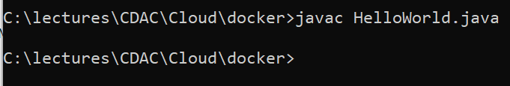
‘Hello World’ in Java using Docker
Create HelloWorld.java in C:\lectures\CDAC\Cloud\docker\hello-world-java\HelloWorld.java
public class HelloWorld {
public static void main(String[] args) {
System.out.println("Hello, World");
}
}
Compile: javac HelloWorld.java
Test: java HelloWorld

Slide 26
Create Dockerfile
C:\lectures\CDAC\Cloud\docker\hello-world-java\Dockerfile
# Use the official OpenJDK image as a parent image
FROM openjdk:latest
# Set the working directory to /app
WORKDIR /app
# Copy the current directory contents into the container at /app
COPY . /app
# Compile the Java code
RUN javac HelloWorld.java
# Run the program when the container starts
CMD ["java", "HelloWorld"]
These will be created/added because of the commands in Dockerfile
HelloWorld.class
.app folder
We want JDK, but it comes with Oracle Linux User Space (not Kernel)
OpenJDK
Oracle Linux
Docker (VM with a Linux Kernel)
These two are already there
Our OS (Host)

Slide 27
End Result
These will be created/added because of the commands in Dockerfile
HelloWorld.class
.app folder
HelloWorld.class
Layer 4
We want JDK, but it comes with Oracle Linux User Space (not Kernel)
OpenJDK
.app folder
Layer 3
OpenJDK
Layer 2
Oracle Linux
Oracle Linux
Layer 1
Docker (VM with a Linux Kernel)
Resulting Docker Image
These two are already there
Our OS (Host)

Slide 28
Build and Execute
# Build the Docker image
docker build -t java-hello-world .
# Run the Docker container
docker run java-hello-world

Slide 29
Pushing Docker Image to DockerHub
# Login to Docker Hub
docker login
# Tag the local image
docker tag java-hello-world newdelthis/java-hello-world:1.0
# Push the image to Docker Hub
docker push newdelthis/java-hello-world:1.0

Slide 30
Stop and Remove All Running Containers
docker stop $(docker ps -a -q)
docker rm $(docker ps -a -q)

